Slide 1


Flights Network Analysis
Web Analytics
Team Neo
Anusuya Manickavasagam: A0163300Y,
Chinnasubbareddygari Mohan Reddy: A0163433L ,
Gello Mark Vito: A0163448Y,
Indumathi Nagarajan: A0163441M,
Muni: A0163382E, Pradeep: A0163453H

Slide 2



01
Agenda
Problem Statement
Tools – a note about Neo4J
About Dataset
Graph Schema
General Network Measures
Alternate routes Recommendation
Key Players (Airports)
Community Detection
Limitations/Further Enhancements
Notes:
Just each line for all the items. Try to make it as a story.

Slide 3
02
Problem Statement
We would like to define and prepare the airline data schema currently in relational data format to a discoverable graph database.
Once we build the graph, we would like to run the graph analysis techniques and gain interesting insights in to the data which otherwise is difficult if done directly on relational data.
Notes:
Mohan – Problem Statement/Tools

Slide 4

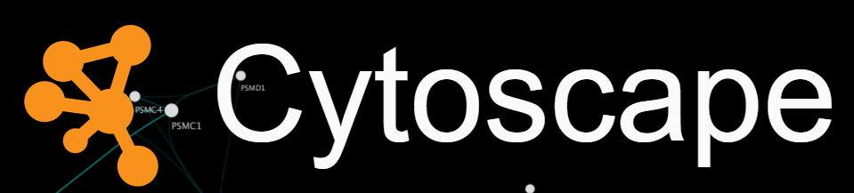

03
Tools – A note about Tools
Market leader platform for Connected Data
To Operate using a query language
Persistent with a scalable, reliable database systems
Network Data Analysis
Network Data Visualization
Notes:
We have used Neo4J which is a market leader platform for connected data. Cypher query is used for the querying the graph in Neo4j. Further we have used the Cytoscope and Gephi for general network analysis and Key Players/Community detection.

Slide 5

04
About Dataset
Airports
Airport_id, airport_name, city, country, airport_iata, airport_icao
Airline_iata, airline_id, source_airport_id, dest_airport_id, codeshare, stops
Airport_latitude, airport_longitude, airport_altitude, airport_timezone
Some clean up was required to change empty values to Unknown
routes
http://openflights.org/data.html
https://raw.githubusercontent.com/jpatokal/openflights/master/data/airports.dat
Notes:
Mark – IATA, ICAO
Codeshare – if they are sharing the route with other airlines, however airline name is not known. It is Y, if it shares.
Airline id: BA, SG
Airport_Id – Singapore you will see in further slides has 3 airports of which 2 are operational.
stops

Slide 6
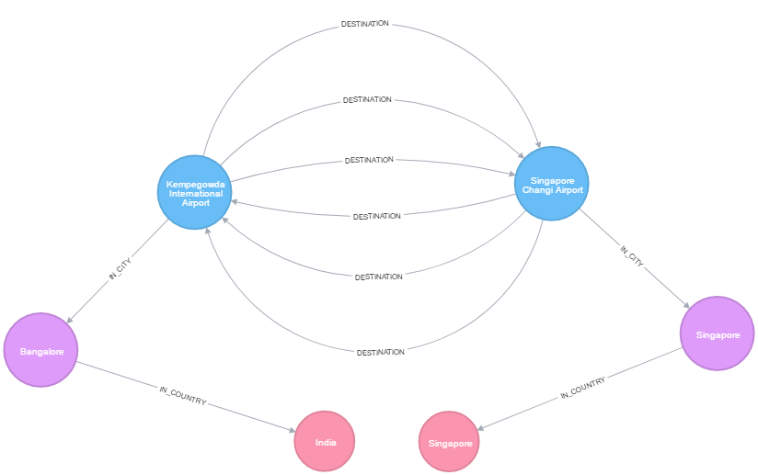
05
Graph Schema
Notes:
Raw data is in 2-3 files. Baesd on the understanding of raw data, we feed the data in graph and this is the schema. Let’s say there is node Singapore changi is In_CITY->Singapore in COUNTRY-> Singapore
Other airport is Kempagowda airport -> in_city -> Bangalore -> In_Country India.
The Edges shows the destination Airline id. So between Singapore and bangalore 3 flights flies from Singapore to Bangalore and Bangalore -> Singapore.
Sometimes flight may depart from a airport but don’t arrive so in that case outside node may not be equal to incoming connection.

Slide 7
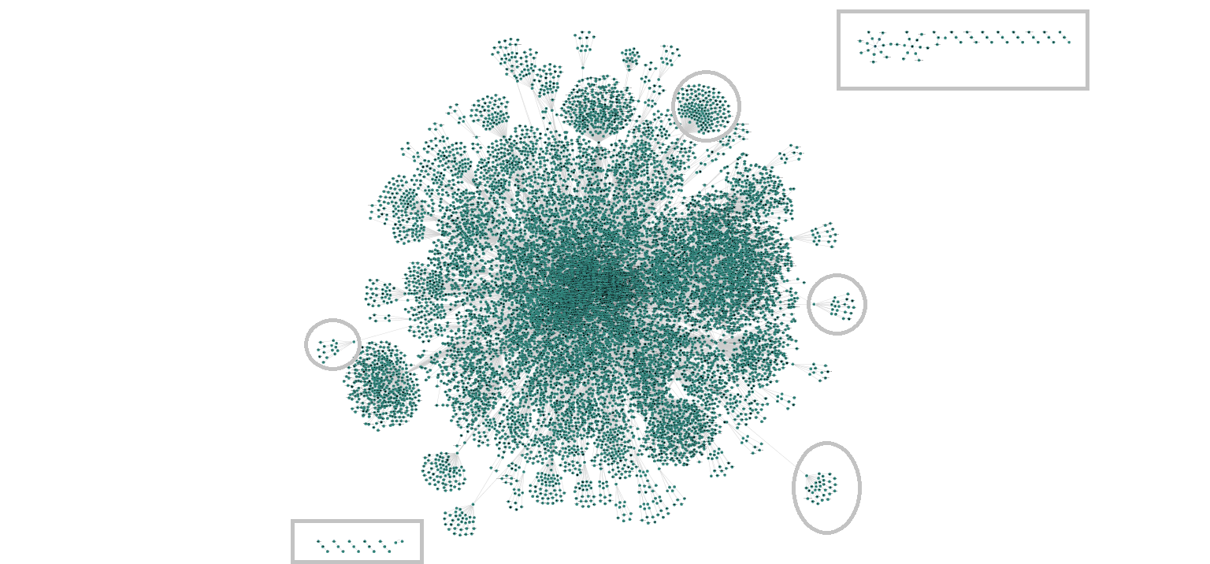
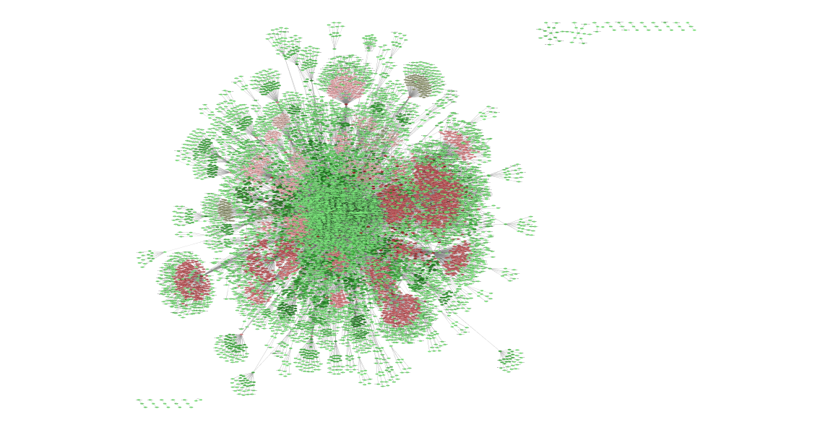
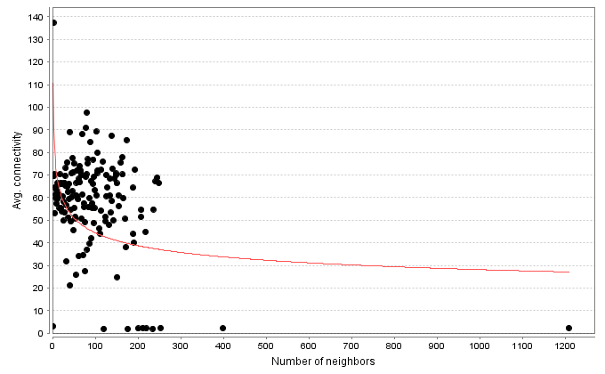
06
Full graph and general network measure
Scale Free Networks
Local Recurrent patterns shows
motifs
Average #of Neighbors ~ 4
Network diameter – 14
Notes:
This is a scale free network and as we can see degree distribution take the power law.
We also observed on the motifs pattern using Cystoscope that there are recurrent patterns exist as shown in diagram
We ran the Network Analysis in cystoscope which provides different general network analysis results.
You can observe that there are some nodes which are not connected. Zooming in to these we observed that there are airports (like Antarctica) which are not offering any flight services.
So to dig more in to it, we queries Neo4j for all the airports for Singapore city and tried to understand the pattern. Let’s see on the next slide.

Slide 8
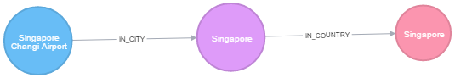
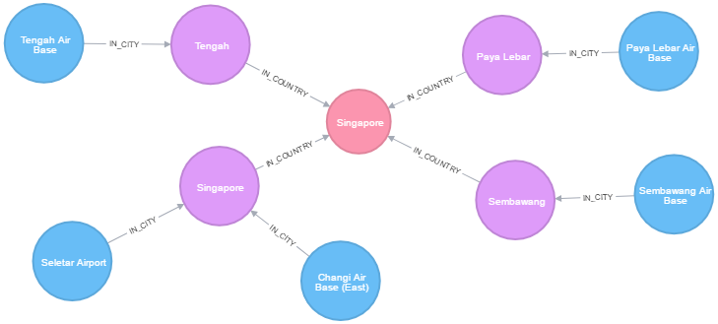
07
Airports in Singapore
With Flight Service
Without Flight Service
Notes:
With more understanding now let’s try to compare the density between airports on next slide.

Slide 9
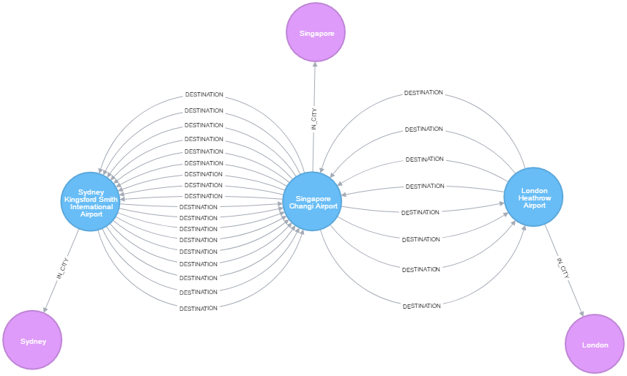
08
Density - Singapore-London vs Singapore-Sydney
Notes:
In this problem, we ran the cypher query to fetch the bidirectional connections between Singapore changi -> London and Singapore Changi <-> Sydney. Between Changi and Sydney network is dense.
May be other parts of world to Sydney, flights are using Singapore as Transit.
However we are not able confirm if some flights from Sydney going to London which takes a transit at Singapore.
Now I invite Muni to talk about further slides.

Slide 10
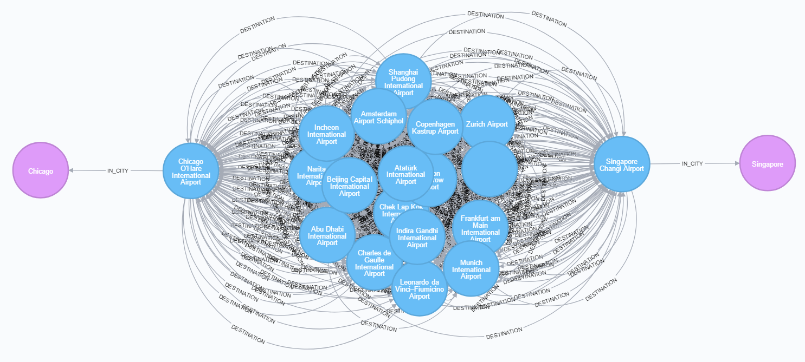
09
Shortest Path Singapore - Chicago

Slide 11
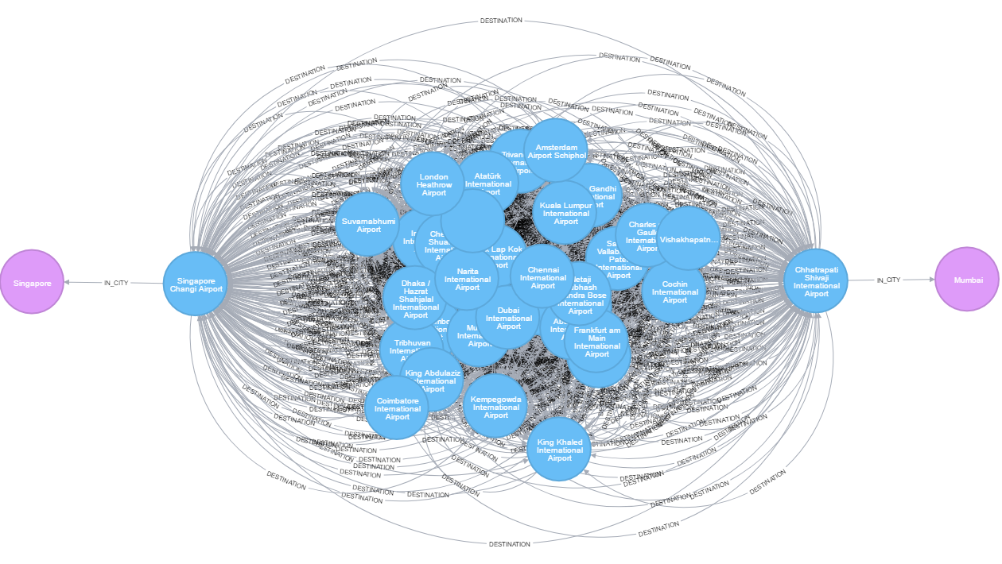
10
Singapore - Mumbai: One Stop Routes

Slide 12
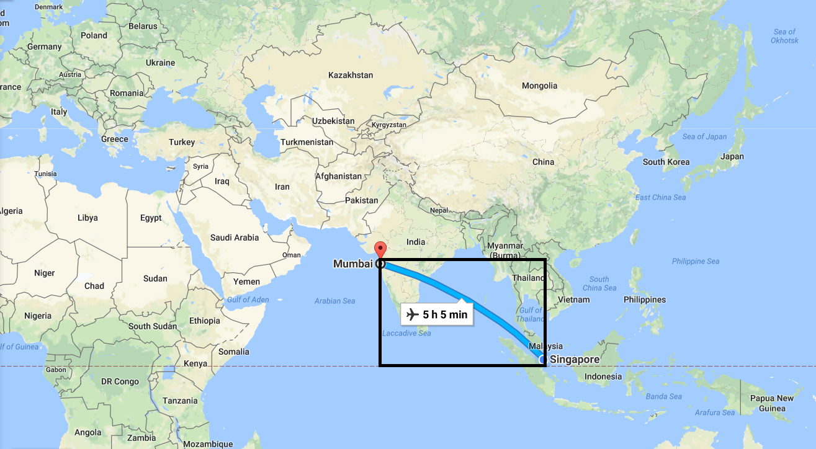
11
Singapore - Mumbai: On Map

Slide 13
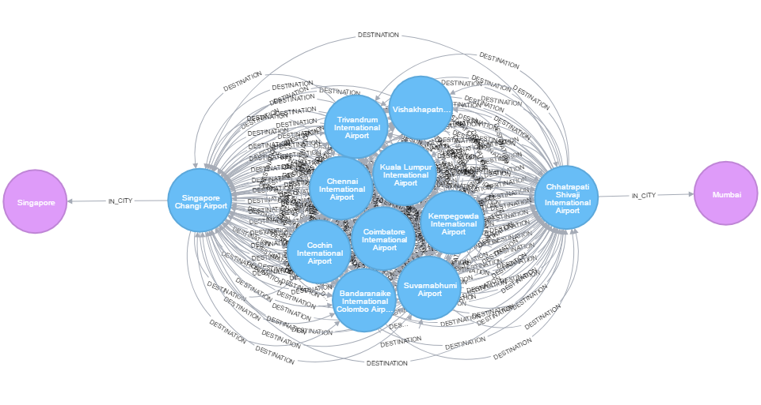
12
Singapore - Mumbai: One Stop Routes (Optimized)

Slide 14
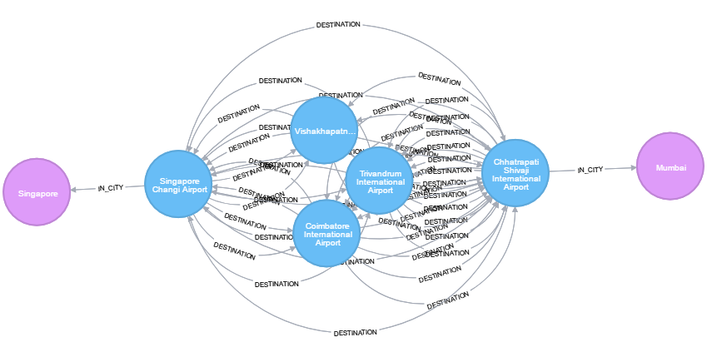
13
Singapore - Mumbai: One Stop Routes (Optimized+)

Slide 15

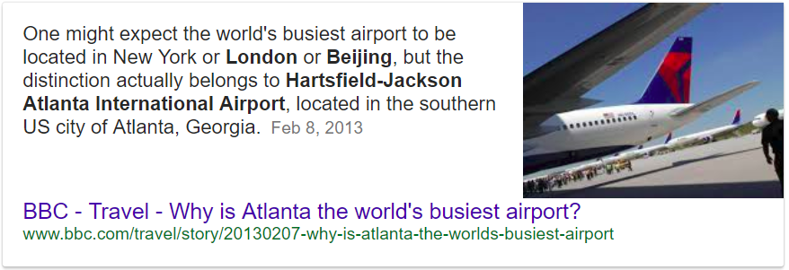
14
Key Players – Page Rank
Key Airports | Page Rank
Hartsfield Jackson Atlanta International Airport | 0.00349
Chicago O'Hare International Airport | 0.00215
Dallas Fort Worth International Airport | 0.00199
Los Angeles International Airport | 0.00199
Beijing Capital International Airport | 0.00190
Charles de Gaulle International Airport | 0.00184
London Heathrow Airport | 0.00183
Singapore Changi Airport | 0.00174
1
8

Slide 16
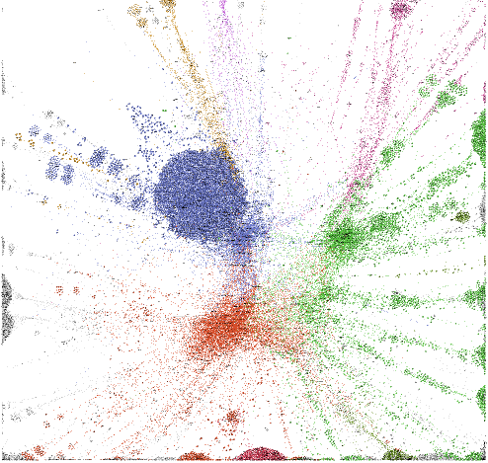
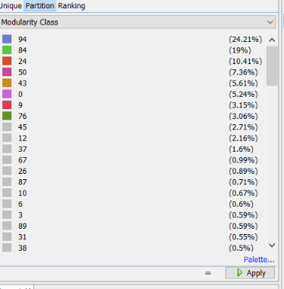
15
Key Communities
AU
US
Asia/EMEA
EU
Notes:
Vincent D. Blondel, Jean-Loup Guillaume, Renaud Lambiotte, Etienne Lefebvre - Fast unfolding of communities in large networks (2008)
Figure 1. Visualization of the steps of our algorithm. Each pass is made of two phases: one where modularity is optimized by allowing only local changes of communities; one where the found communities are aggregated in order to build a new network of communities. The passes are repeated iteratively until no increase of modularity is possible.

Slide 17
16
Limitations
Didn’t have full transit routes information
Explicit information about commercial/Non commercial is missing
Flight Schedule could be used to further enhance the graph analysis

Slide 18

17
Q/A

